Slide 1

TASK – 1 : Web scraping to gain company insights
DATE : 02/04/2023

Slide 2
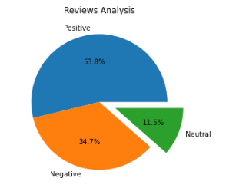
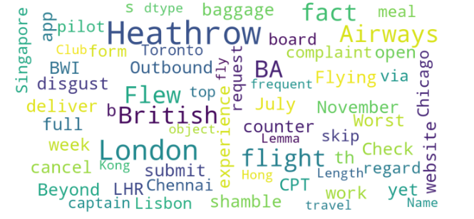
INSIGHTS FROM CUSTOMER REVIEWS
FROM CLEANING 1000 REVIEWS GIVEN BY THE CUSTOMERS, WE OBTAINED
Positive Reviews - 538
Negative Reviews - 347
Neutral Reviews – 115
WORD CLOUD OF KEYWORDS USED IN REVIEWS

